Slide 1
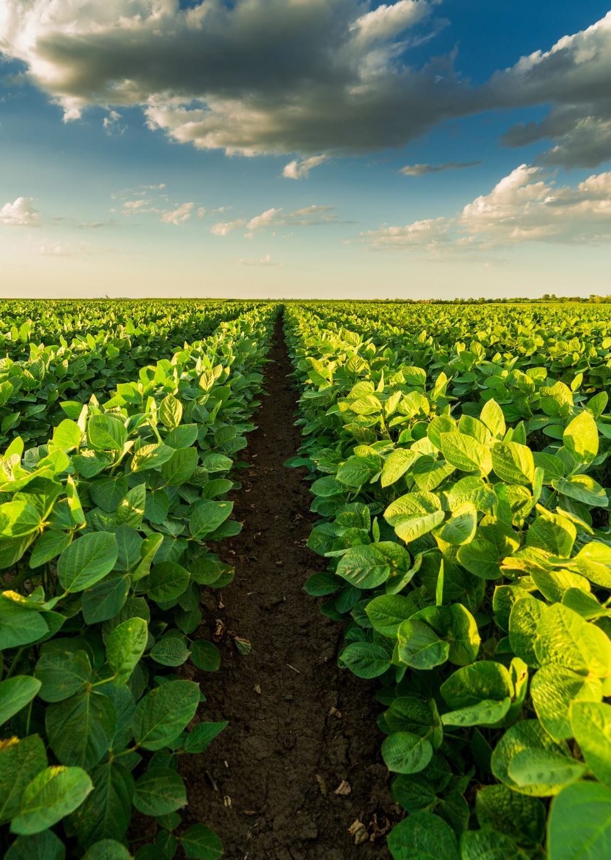
Cassava Disease Detection and Classification – A Comparative study of Fuzzy Logic and Traditional Machine Learning
Presented By:
Aksheya Kannan Subramanian (25502870)
Michael Acquah (84978417)

Slide 2

Introduction
Plant diseases pose a significant threat to global food security, impacting crop yields and economic stability. Managing such issues requires early detection and quick action. Current AI-driven plant disease detection heavily relies on Convolutional Neural Networks (CNNs). However, they require extensive datasets and high computational capabilities. Our approach is to implement fuzzy image processing as an alternative solution that will enable us to handle uncertainty and imprecision using fuzzy logic principles. We enable this through the combined use of both existing CNN models and a defined FNN. The comparative study shows the increased accuracy between traditional methods and the fuzzy approach.

Slide 3
objectives
Develop a fuzzy image processing framework for identifying Cassava plant diseases through identification of specific features in the diseased leaves
Integrate fuzzy logic-based algorithms to handle imprecise data and variable disease symptoms
Assess the effectiveness of fuzzy logic techniques compared to conventional image processing methods and perform a comparative study
Create a prototype application that can assist farmers with real time disease detection

Slide 4
Literature review
No. | Paper Details | Methodology Used | Result | Merits and Demerits
1. | Title : Plant Disease Detection Using Deep Learning Authors: Bahaa S. Hamed, Mahmoud M. Hussein, Afaf M. Mousa Year: 2023 | The study utilizes pre-trained convolutional neural networks (CNN), specifically EfficientNetV2S. Fine-tuning of pre-trained EfficientNetV2S for improved plant disease classification. Handling of noisy datasets: Adding Gaussian noise to simulate real-world conditions like shadows, varying textures, and brightness. Data Augmentation: Includes rotation, flipping, scaling, and other transformations to improve robustness. Use of the Plant Diseases Dataset containing 87,000 images across 38 classes. | The proposed solution achieved an accuracy of 95.01%. | Merits The model uses EfficientNetV2S, which is efficient and accurate for classification tasks. The methodology reduces overfitting and computational costs with techniques like layer freezing and fine-tuning. Demerits While the model is effective, it requires large computational resources for training.

Slide 5
Literature review
No. | Paper Details | Methodology Used | Result | Merits and Demerits
2. | Title : Papaya Disease Detection Using Fuzzy Naïve Bayes Classifier Authors: Wahyuni Sari, Yulia Kurniawati, Paulus Santosa Year: 2020 | This research involves fuzzification of symptom weights using Triangular Fuzzy Numbers based on the Saaty scale. This converts the linguistic descriptions into numerical values for processing by the Naive Bayes Classifier The system uses a forward chaining search method for comparison | The proposed solution achieved an accuracy of 90%. | Merits The use of fuzzy logic effectively addresses the uncertainty and ambiguity associated with symptom assessment. Demerits The paper lacks detailed information on the datasets composition and the validation methods employed.

Slide 6
Literature review
No. | Paper Details | Methodology Used | Result | Merits and Demerits
3. | Title : Disease detection on plant leaf using K Means segmentation with fuzzy logic SVM algorithm. Authors: M. Sowmya, Dr. Bojan Subramani Year: 2022 | Image Preprocessing K Means Clustering Feature Extraction Fuzzy logic Classification SVM Classification | Evaluation is based on a dataset of 500 images. The research achieves an improved accuracy in disease detection but no quantitative results were stated. | Merits: The combination of K Means, fuzzy logic and SVM leverages the strength of each techniques. Demerits: The paper lacks a comprehensive evaluation with comparison to state of the art techniques.

Slide 7
Literature review
No. | Paper Details | Methodology Used | Result | Merits and Demerits
4. | Title : Early Detection and Classification of Paddy Diseases with Neural Networks and Fuzzy Logic Authors: Mohd Adzhar, Sofianita Mutalib, Shuzlina Abdul Rahman | Image Acquisition Image Preprocessing Feature Extraction Back-Propagation Neural Network. Fuzzy Logic | The proposed system had a reported accuracy of 74.21%. | Merits The system is automated which reduces the reliance on human experts, saving time and resources. Demerits The systems performance is only evaluated on a specific set of Malaysian paddy diseases.

Slide 8
Literature review
No. | Paper Details | Methodology Used | Result | Merits and Demerits
5. | Title : Leaf Disease Detection and Grading using Computer Vision Technology and Fuzzy Logic. Authors: Aakanksha Sopra, Ritika Arora, Shanu Sharma Year: 2015 | Image Preprocessing Feature Extraction K Means Clustering Artificial Neural Networks Fuzzy logic | The proposed system offers a promising approach to leaf disease detection but the paper doesn’t state the overall accuracy | Merits: A graphical user interface was developed for ease of use. Demerits: Limited dataset. The paper lacks important details about the ANN architecture.

Slide 9
Methodology – WATERFALL MODEL
Requirements Gathering
Design
Implementation
Testing
Deployment

Slide 10
Methodology – WATERFALL MODEL
Requirements Gathering : The Cassava Plant disease dataset was acquired from Kaggle, which is recognized as one of the best resources for research data.
Design : The Traditional and Fuzzy System model structures were designed based on the appropriate literature surveys conducted
Implementation: Using MobileNetV2 as a base both traditional and fuzzy hybrid models were executed
Testing – Test accuracy across the traditional model and fuzzy hybrid models were compared. The fuzzy model accuracy was also compared with a pre-existing traditional model from literature survey.
Deployment – A simple GUI was deployed to portray the workings of the model by implementing user inputs.

Slide 11

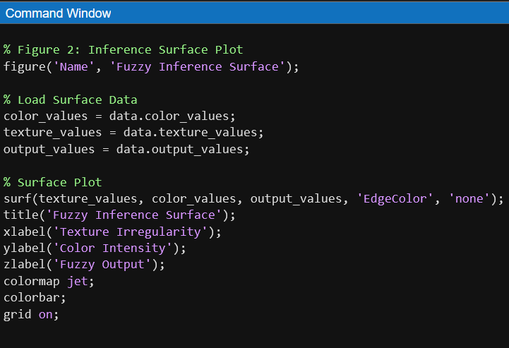
Matlab visualization

Slide 12
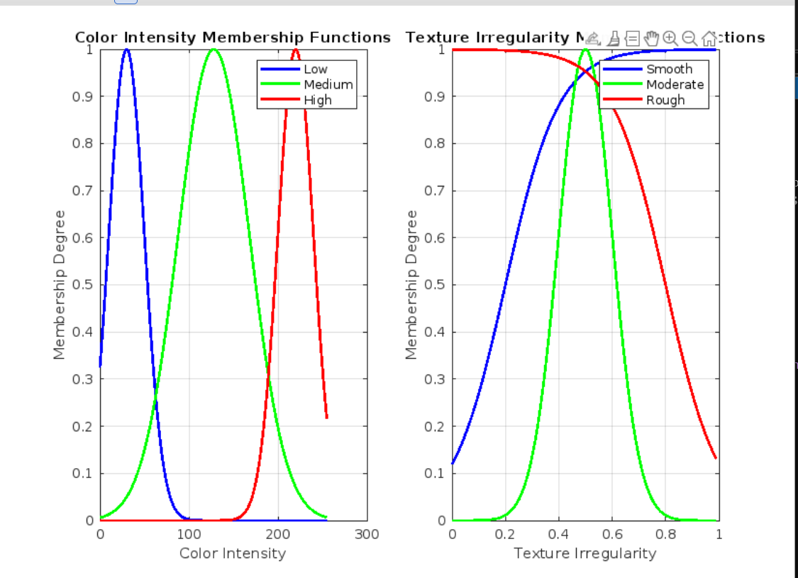
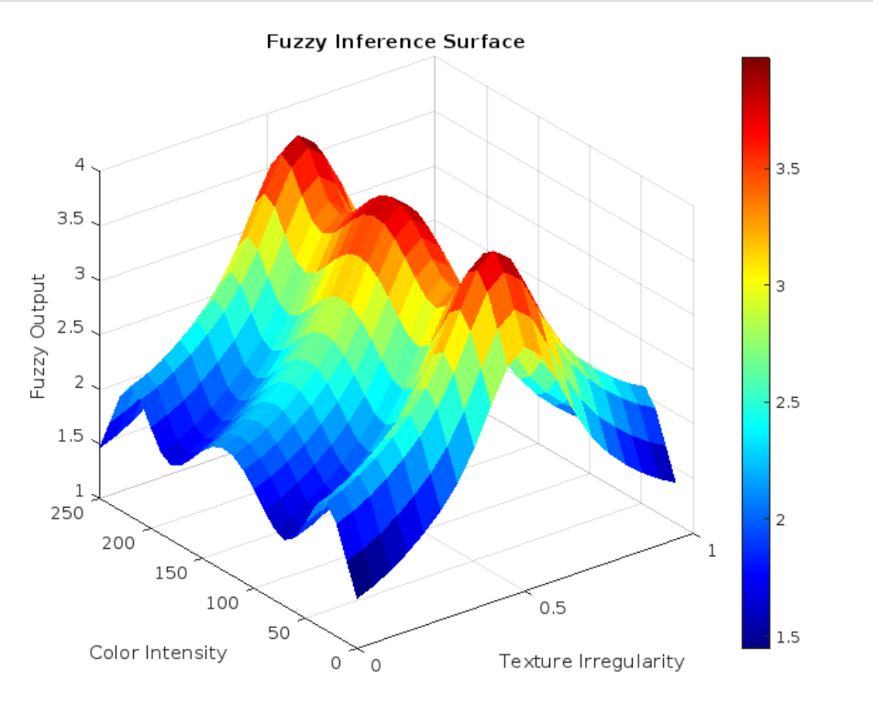
Matlab visualization

Slide 13
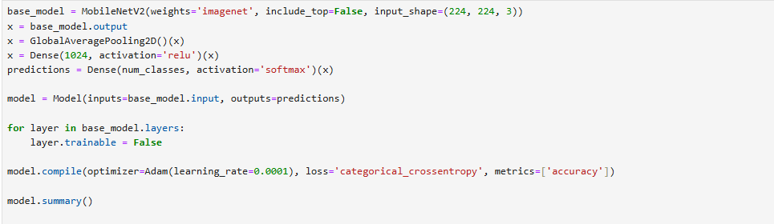
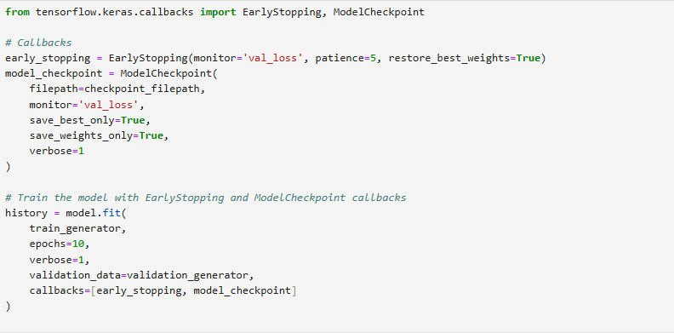
IMPLEMENTATION
Non Fuzzy

Slide 14
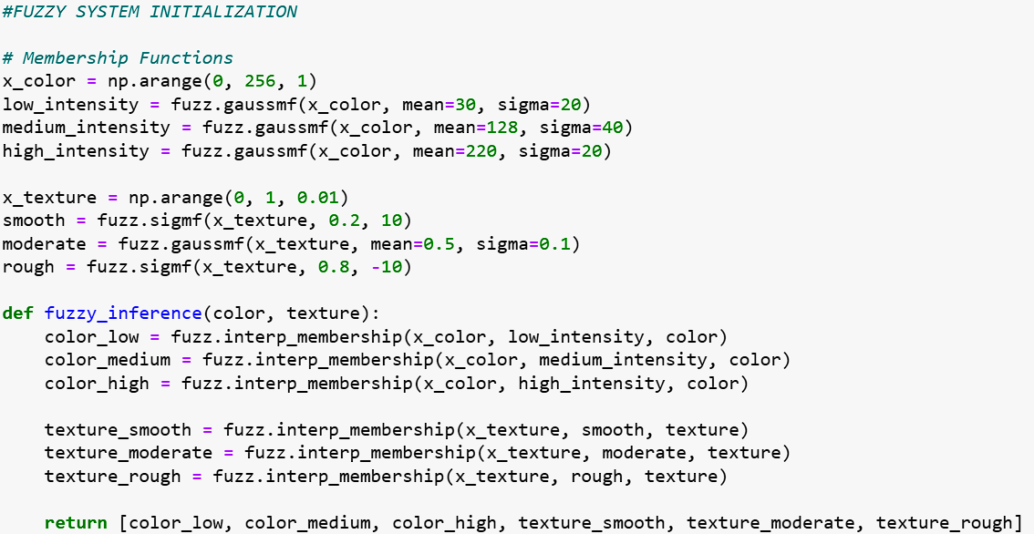
IMPLEMENTATION
Fuzzy

Slide 15
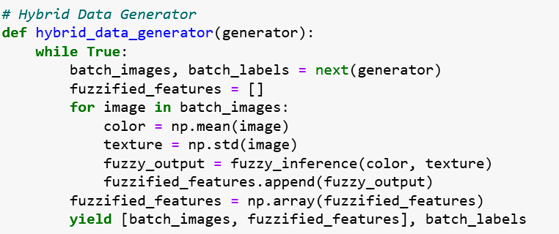
IMPLEMENTATION
Fuzzy

Slide 16
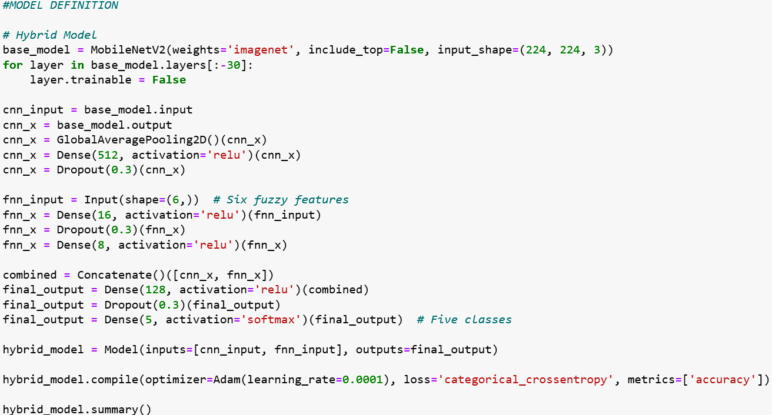
IMPLEMENTATION
Fuzzy

Slide 17
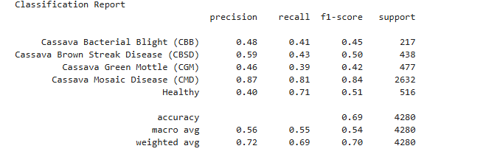
Results
Non fuzzy

Slide 18
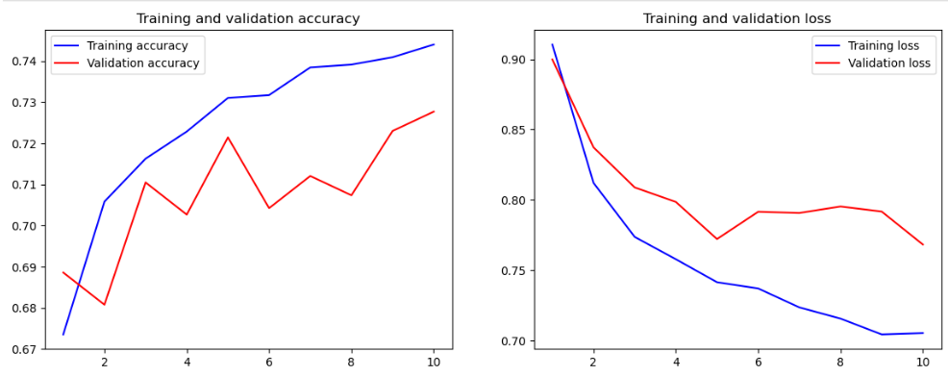
Results

Slide 19
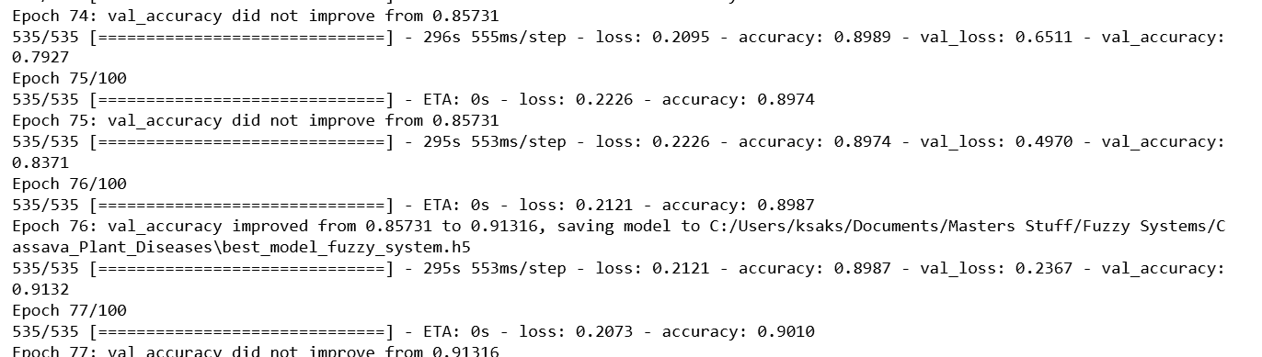
Results
Fuzzy

Slide 20
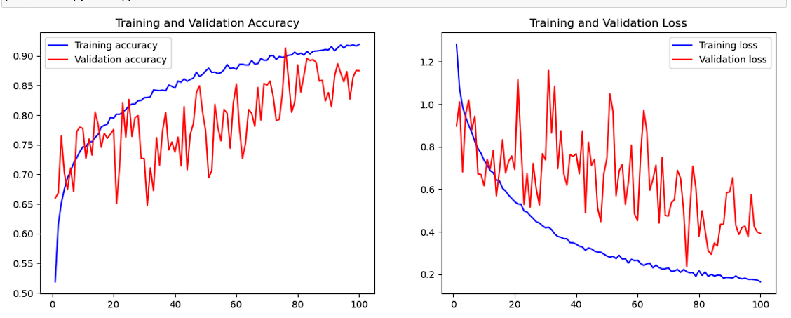
Results

Slide 21
comparison
Accuracy for traditional model – MobileNetV2 - ~69% - 10 epochs
Accuracy for hybrid fuzzy model – CNN + FNN - ~74% - 10 epochs
Training loss and validation loss for traditional models did not generalize at any point over 10 epochs
Accuracy for traditional model – Efficient Net according to Literature Survey Paper [1] ~ 95%
Training loss and validation loss for hybrid fuzzy model was generalizing well over 10 epochs which shows a good working model

Slide 22
COMPARISON - TABLE
Model Type | Accuracy/Loss | Observation
MobileNetV2 | ~69% - 10 epochs | Trial runs over 10 epochs show simple suboptimal outputs
Hybrid Fuzzy Model [CNN (MobileNetV2) + FNN] | ~92% - 100 epochs | Comparatively higher accuracy performing on par with existing traditional models
Efficient Net | ~95% (Literature Survey) | High performing traditional model. However, not performed for Cassava diseases

Slide 23
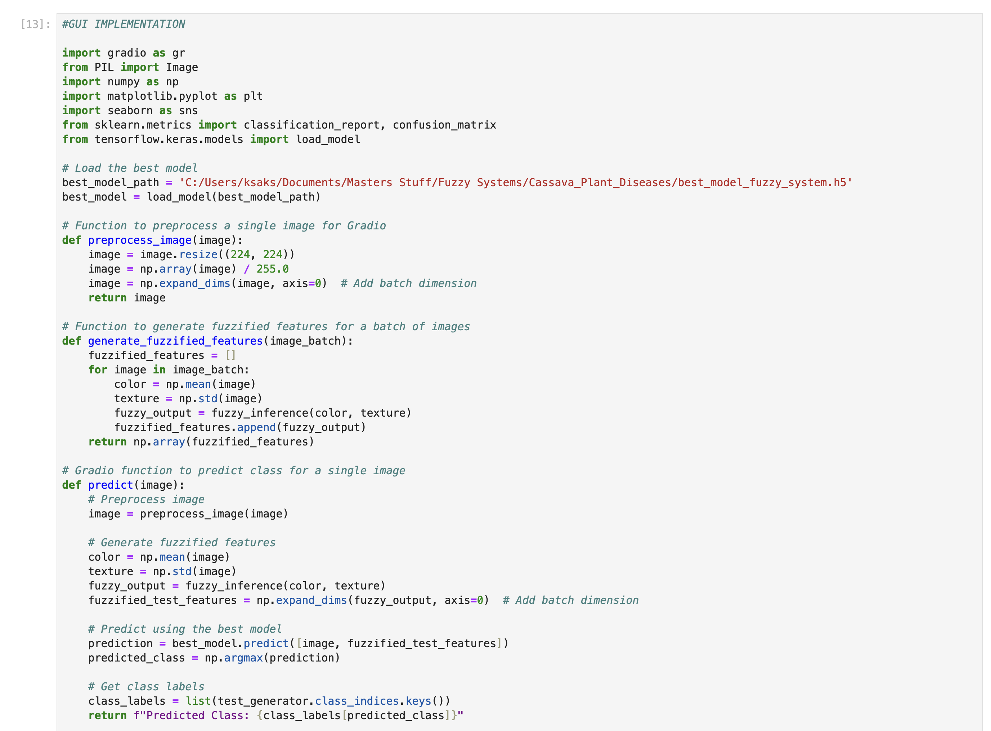
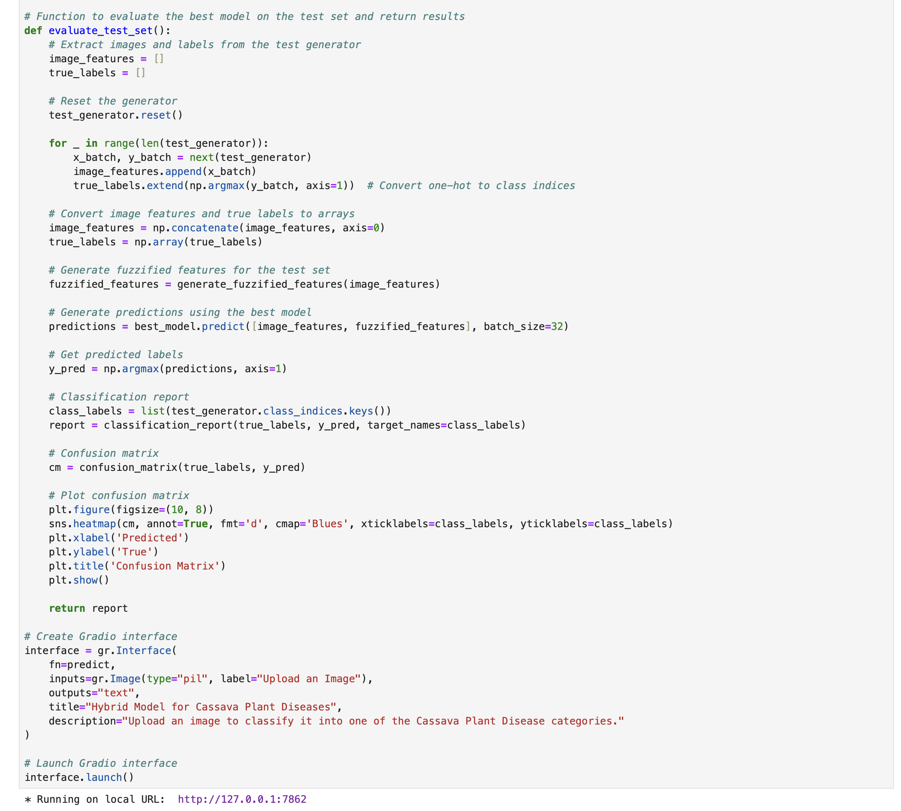
GUI IMPLEMENTATION

Slide 24
Conclusion
This research explored the potential of fuzzy logic as a novel approach for cassava disease detection and classification as compared to traditional machine learning methods.
Future research could focus on refining the fuzzy inference systems, expanding the dataset to encompass a wider range of conditions, and developing hybrid AI models that integrate fuzzy logic with complementary techniques.
Overall, this research shows the great potential of fuzzy logic to transform agricultural disease management, promoting sustainable and resilient farming practices

